Slide 1


جامعة العلمين الدولية
جامعة العلمين الدولية

Slide 2
SOLID Principles
SOLID principles are the design principles that enable us to manage several software design problems.
S: Single Responsibility Principle (SRP)
O: Open closed Principle (OCP)
L: Liskov substitution Principle (LSP)
I: Interface Segregation Principle (ISP)
D: Dependency Inversion Principle (DIP)

Slide 3
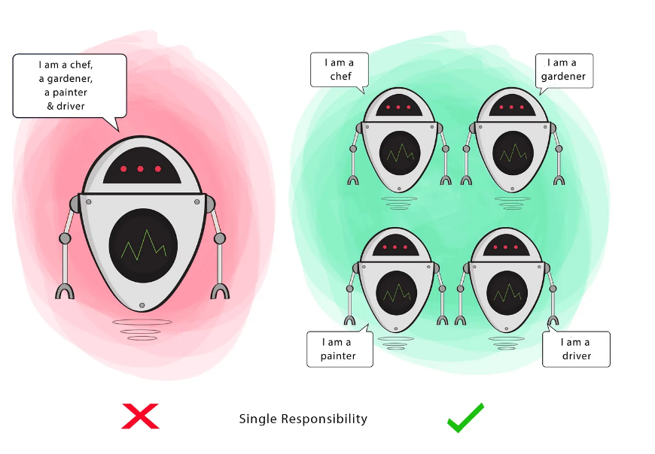
S: Single Responsibility Principle (SRP)
"Every software module should have only one reason to change"
This means that every class, or similar structure, in your code should have only one job to do.
If a Class has many responsibilities, it increases the possibility of bugs because making changes to one of its responsibilities, could affect the other ones without you knowing.

Slide 4
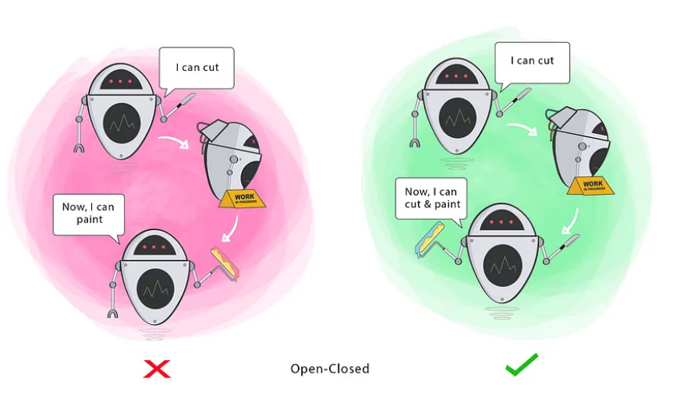
O: Open closed Principle (OCP)
Classes should be open for extension, but closed for modification
Changing the current behaviour of a Class will affect all the systems using that Class.
If you want the Class to perform more functions, the ideal approach is to add to the functions that already exist NOT change them.

Slide 5
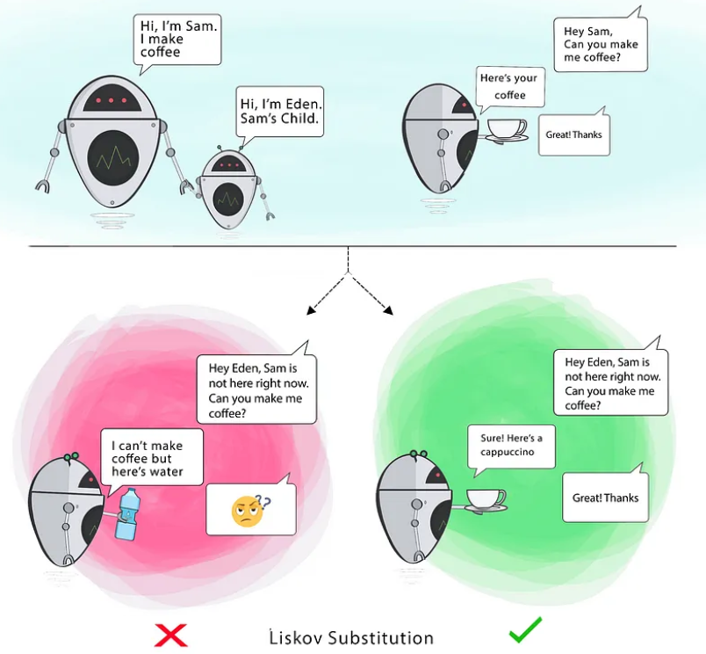
L: Liskov substitution Principle (LSP)
The child Class should be able to process the same requests as the parent Class or it could deliver a result that is of the same type.
The picture shows that the parent Class delivers Coffee(it could be any type of coffee). It is acceptable for the child Class to deliver Cappucino because it is a specific type of Coffee, but it is NOT acceptable to deliver Water.

Slide 6
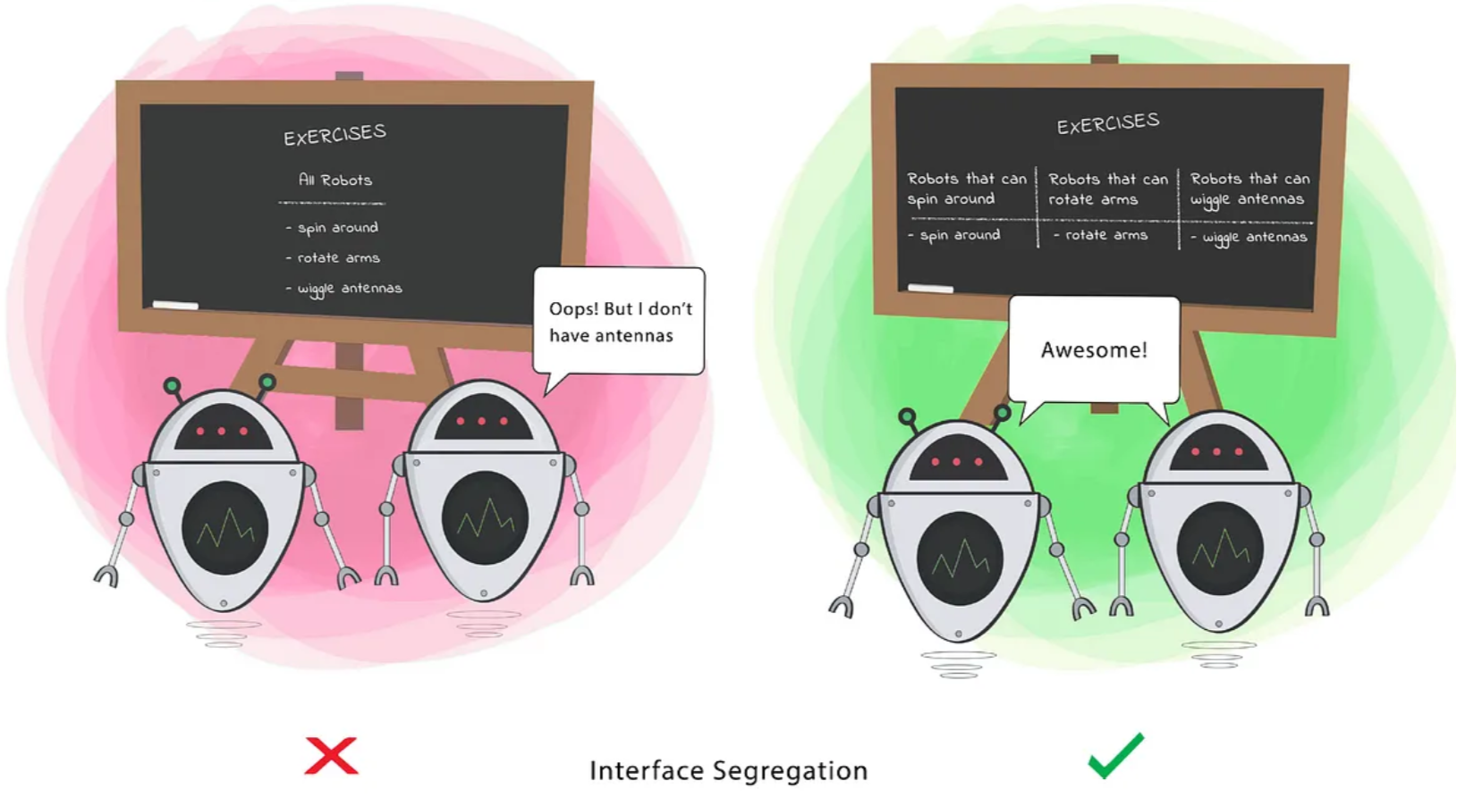
I: Interface Segregation Principle (ISP)
Clients should not be forced to depend on methods that they do not use.
A Class should perform only actions that are needed to fulfil its role. Any other action should be removed completely or moved somewhere else if it might be used by another Class in the future.

Slide 7
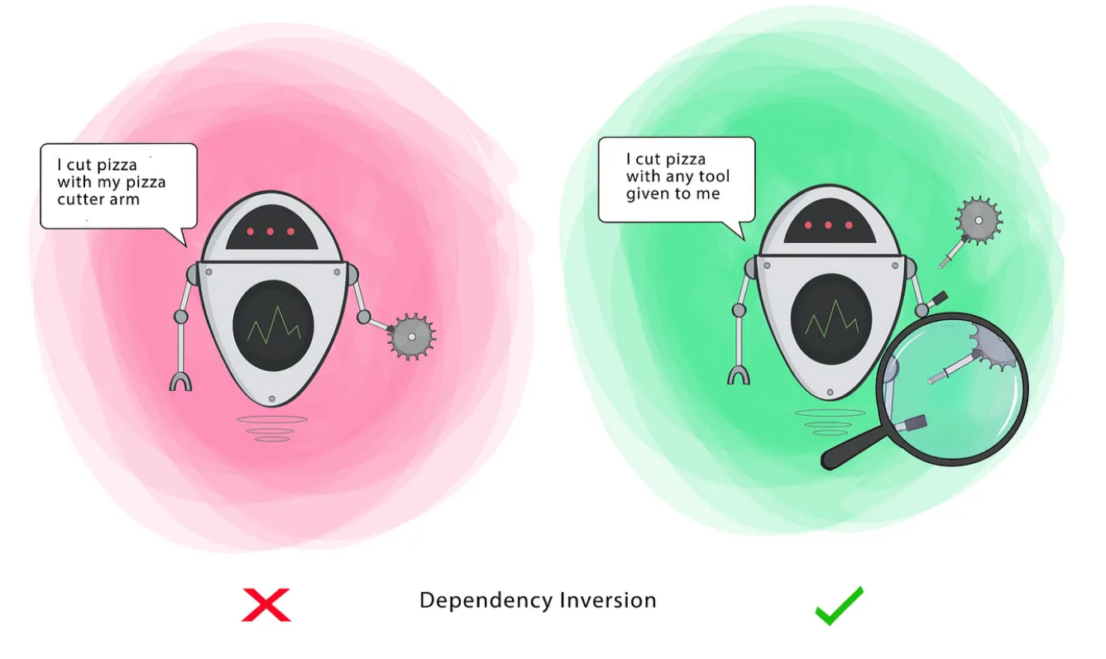
D: Dependency Inversion Principle (DIP)
High-level classes should not depend on low-level classes.
Both should depend on the abstraction.
High-level Module(or Class): Class that executes an action with a tool.
Low-level Module (or Class): The tool that is needed to execute the action
Abstraction: Represents an interface that connects the two Classes.

Slide 8
UML
UML stands for Unified Modeling Language. It’s a language to model software solutions, application structures, system behavior, and business processes.
There are 14 UML diagram types to help you model these behaviors divided into:
Structure diagrams: show the things in the modeled system. In more technical terms, they show different objects in a system.
Behavioral diagrams: show what should happen in a system. They describe how the objects interact with each other to create a functioning system.

Slide 9
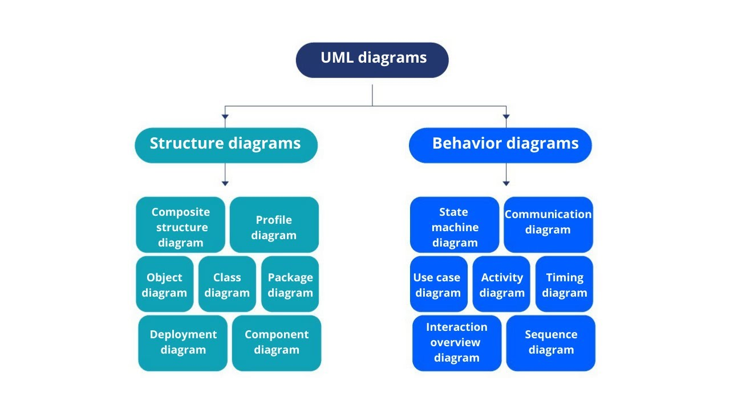
UML diagrams types:

Slide 10
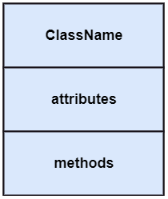
Let’s talk about class diagram
Class diagrams are the main building block of any object-oriented solution which is a type of Structure-diagrams.
It shows the classes in a system, the attributes, the operations of each class, and the relationship between each class.
Each class of the class diagram has three parts:
Name at the top.
attributes in the middle.
operations or methods at the bottom.

Slide 11
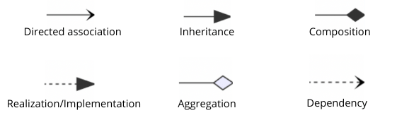
Class diagram cont..
In a large system with many related classes, classes are grouped together to create class diagrams.
Different relationships between classes are shown by different types of arrows as shown in the following figure:

Slide 12
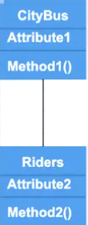
Class diagram relationships:
Association
is the most basic of relationships.
Association means any type of relationship or connection between classes.
describes the reasons for the relationship and the rules that govern the relationship.
association relation is established when two classes are connected to each other in any way.
Bi-directional.
We represent an association as a straight line.
Example:
we show a direct link between a city bus and its riders using an association line.

Slide 13
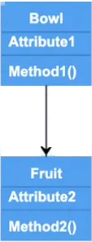
Class diagram relationships cont..
Directed association
shows a strong relationship between classes.
The classes must communicate.
One-way direction (Non-reversible).
We represent a direct association with an arrow pointing to our object class.
Example:
a bowl might contain fruit.
The bowl acts as a container class for the fruit class.

Slide 14
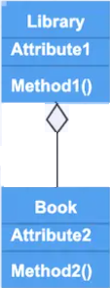
Class diagram relationships cont..
Aggregation
The child class can exist independent of the parent element.
We represent an aggregation by a straight line followed by a diamond.
“have” and ” has a’’.
Example:
A book still exists if somebody checks it out from the library.

Slide 15
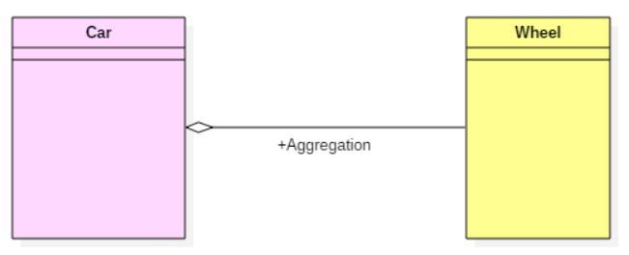
Aggregation cont..
Car consists of wheels, engine, gearbox, steering, and the main body, etc.
Here, car to the wheel is one Aggregation, car to the engine is another aggregation, car to gearbox another, and so on.
A car needs a wheel to function correctly. However, we cannot say the same with a car. The same logic can be applied to bike, bicycle, or any other vehicle but not a particular car.
Here, the wheel object is meaningful even without the car object. It is known as an aggregation relationship.

Slide 16
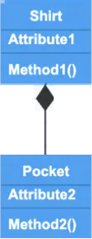
Class diagram relationships cont..
Composition
Show up in UML class diagrams when we want to show a similar association to aggregation.
Composition associations show relationships where the sub-object exists only as long as the container class exists.
We represent composition by a straight line followed by a shaded diamond.
Example
A pocket on the front of a shirt cannot exist if we destroy the shirt.

Slide 17
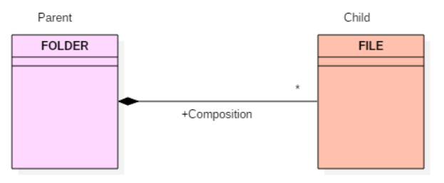
composition cont..
Example
The folder could contain many files, while each File has exactly one Folder parent. If a folder is deleted, all contained files are removed as well.

Slide 18
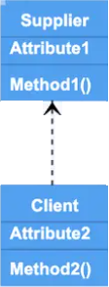
Class diagram relationships cont..
Dependency
Show us where two elements depend on each other, but in a less strong relationship than a basic association.
Changes to the parent class will also affect the child class.
We represent dependency by an arrow with dashed line.
Example
Dependency shows a supplier-client type of relationship.

Slide 19
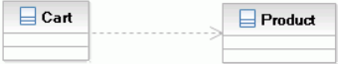
Dependency cont..
Example
A Cart class depends on a Product class because the Cart class uses the Product class as a parameter for an add operation.
The above relationship indicates that a change to the Product class might require a change to the Cart class.

Slide 20
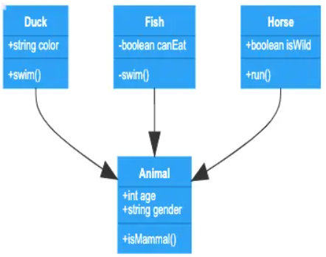
Class diagram relationships cont..
Inheritance
We use Inheritance arrows to show a child class inherits functionality from the parent class.
We represent inheritance with an arrow ended by a shaded triangle.
Example
Animal is the class.
Duck, fish, and horse are subclasses.

Slide 21
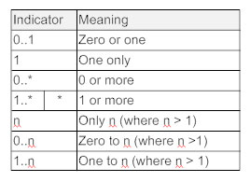
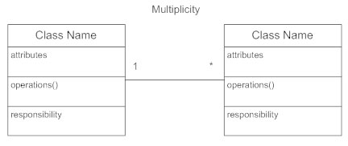
Multiplicity (Cardinality)
Inheritance
Place multiplicity notations near the ends of an association.
These symbols indicate the number of instances of one class linked to one instance of the other class.
Example
one company will have one or more employees, but each employee works for just one company.

Slide 22
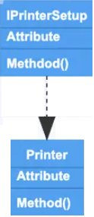
Class diagram relationships cont..
Realization/Implementation
to indicate a place where one class implements the function defined in another class.
We represent inheritance by an arrow with a dashed line ended by a shaded triangle.
Example
the printer setup interface sets the printing preferences that are being implemented by the printer.

Slide 23
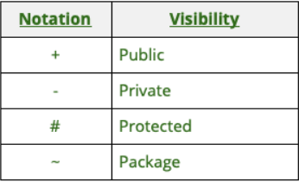
Class diagram visibility
A public member is visible anywhere in the program and may be called by any object within the system.
A private member may be used only by the class that defines it.
A protected member may be used only by (a) the class that defines it or (b) a subclass of that class.
A package member is visible to other classes within the same package

Slide 24
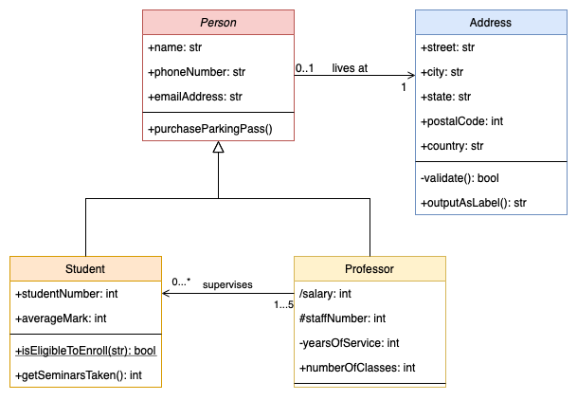
Example(1) student & professor

Slide 25
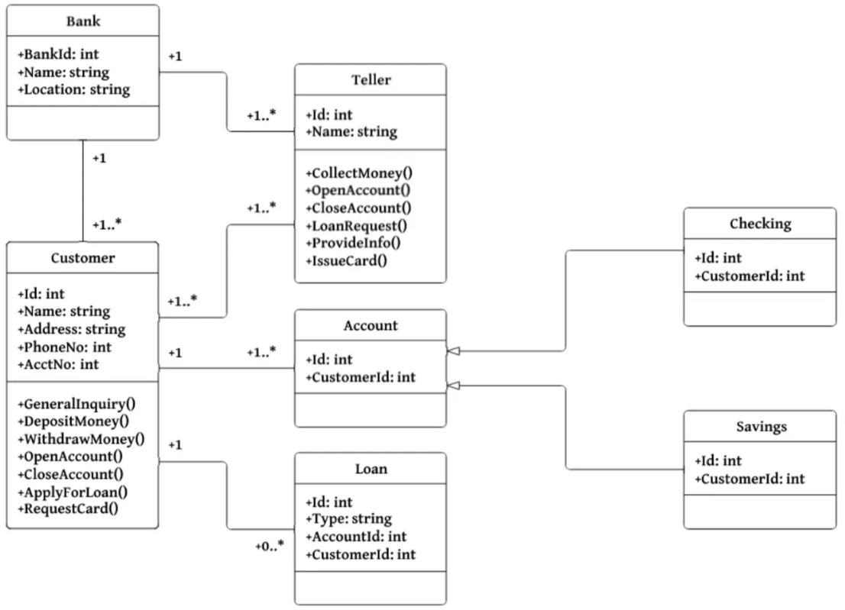
Example(2) Bank

Slide 26
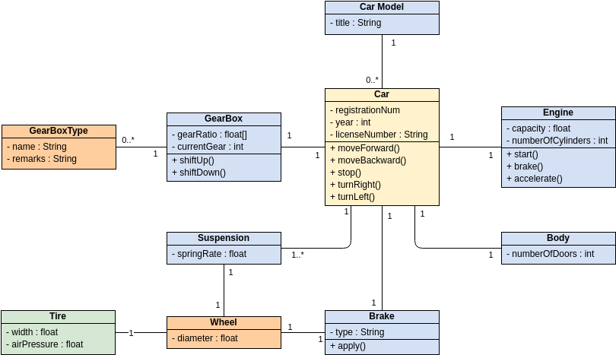
Example(3) Car

Slide 27
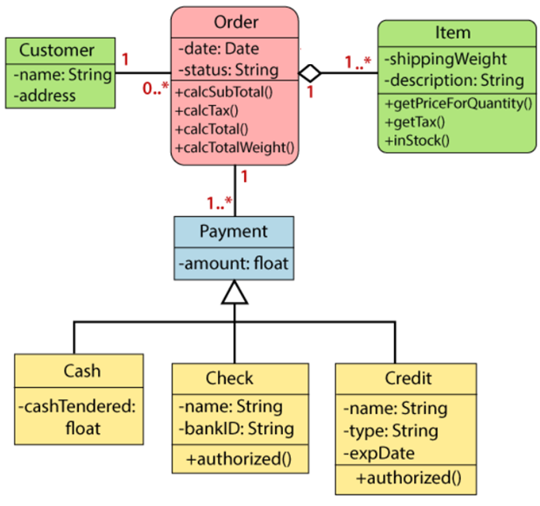
Example(4) online order system

Slide 28
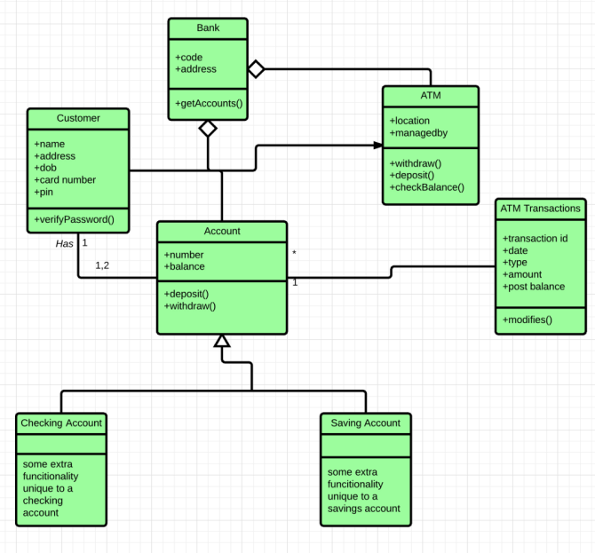
Quiz1 class diagram Bank & ATM

Slide 29
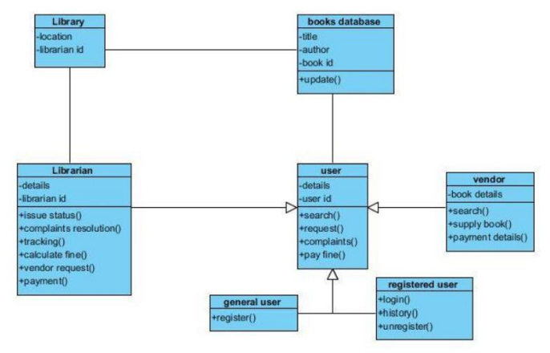
Quiz2 class diagram LMS

